Slide 1
Computer-Based Performance Assessments
from NAEP and ETS
and their relationship to the NGSS Aaron Rogat Educational Testing Service

Slide 2
NAEP SCIENCE
2015 & 2019

Slide 3
Background: NAEP Framework
Predated NRC Framework for K-12 Science Education, but conceived while Taking Science to School (TSTS) in the works
With regard to content, Benchmarks & NSES is core to the work
Framework focus on a combination of content and practice
Practices framed in the following way
Identifying Science Principles (recalling knowledge)
Using Science Principles (using knowledge to construct explanations & predictions)
Using Scientific Inquiry (using knowledge to validate, generate and revise knowledge)
Using Technological Design

Slide 4
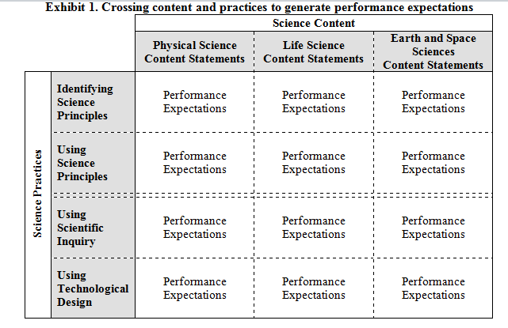
Background: NAEP Considers Content and Practice
From 2009 NAEP Science Framework

Slide 5
Background: Task Types in NAEP Science
MC & CR items
Simpler Processes or Tasks
DI
ICT
HOT
Discrete Items
Performance Assessment
More Complex Processes or Tasks
Performance Assessment
More Complex Processes or Tasks
Hands on Tasks
Interactive
Computer-Based
Tasks

Slide 6
Background: Performance Assessments in NAEP
ICTs and HOTs will be administered in 2015 and 2019, but how they will be reported is yet to be determined
Have decided science inquiry should be the target for measurement by ICTs and HOTs
For 2015 and 2019 tasks will have a refined competency model of science inquiry to inform development of ICTs and HOTs

Slide 7
Competency Model for ICTs & HOTs
What is a competency model?: Defined set of knowledge, skills, and abilities necessary to be proficient in science
We attempted to unpack and refine science inquiry with TSTS and its research in mind

Slide 8
Defining Science Inquiry for NAEP
[Science inquiry] is a process of knowledge creation that involves the generation and evaluation of evidence through empirical investigation and results in the refinement of explanations, models, or theories
(Strand 2 of Taking Science to School, NCR, 2007).
Notes:
If just look at NAEP framework, you see some clear competencies to focus on

Slide 9
Main Components of Science Inquiry for NAEP
P1. Ability to pose preliminary ideas
P2. Ability to design or critique investigations
P3. Ability to conduct investigations
P4. Ability to interpret data and relate patterns to theoretical models
P5. Ability to use evidence to make conclusions

Slide 10
Comparison to NGSS Practices
NGSS
Practice 1. Asking Questions and Defining Problems
Practice 2. Developing and Using Models
Practice 3. Planning and Carrying Out Investigations
Practice 4. Analyzing and Interpreting Data
Practice 5. Using Mathematics and Computational Thinking
Practice 6. Constructing Explanations and Designing Solutions
Practice 7. Engaging in Argument from Evidence
Practice 8. Obtaining, Evaluating, and Communicating Information
Science Inquiry Competency Model
NA
P1. Ability to pose preliminary ideas
P2. Ability to design or critique investigations
P3. Ability to conduct investigations
P4. Ability to interpret data and relate patterns to theoretical models
P5. Ability to use evidence to make conclusions

Slide 11
Subcomponents of Science Inquiry
P1. Ability to pose preliminary ideas
P1.A. Ability to pose preliminary testable questions
P1.B. Ability to pose preliminary explanations, models, or theories based on previously learned observations or science principles
P1.C. Ability to make preliminary predictions based on previously learned observations or science principles
P1.D. Ability to communicate or represent questions, explanations, models, or predictions

Slide 12
Comparison to NGSS Practices
Science Inquiry Competency Model
NGSS
P1. Ability to pose preliminary ideas
P1.A pose preliminary testable questions
P1.B. pose preliminary explanations, models, or theories based on previously learned observations or science principles
P1.C. make preliminary predictions based on previously learned observations or science principles
P1.D. communicate or represent questions, explanations, models, or predictions
Practice 1. Asking Questions and Defining Problems
Practice 2. Developing and Using Models
Practice 8. Obtaining, Evaluating, and Communicating Information

Slide 13
Subcomponents of Science Inquiry
P2. Ability to design or critique investigations
P2.A. Ability to identify variables
P2.B. Ability to identify or construct hypotheses
P2.C. Ability to design an investigation (e.g., a fair test)
P2.D. Ability to critique a design of an investigation (e.g., a fair test)
P2.E. Ability to communicate (written, oral, or graphic) a design of a scientific investigation
P2.F. Ability to communicate (written, oral, or graphic) a critique of a scientific investigation

Slide 14
Comparison to NGSS Practices
Science Inquiry Competency Model
NGSS
P2. Ability to design or critique investigations
P2.A. Ability to identify variables
P2.B. Ability to identify or construct hypotheses
P2.C. design an investigation
P2.D. critique a design of an investigation
P2.E. communicate a design of a scientific investigation
P2.F. communicate a critique of a scientific investigation
Practice 3 Planning and Carrying Out Investigations
Practice 8 Obtaining, Evaluating, and Communicating Information

Slide 15
Subcomponents of Science Inquiry
P3. Ability to conduct investigations
P3.A. Ability to select appropriate tools and techniques
P3.B. Ability to use appropriate tools and techniques
P3.C. Ability to implement appropriate data collection procedures

Slide 16
Comparison to NGSS Practices
Science Inquiry Competency Model
NGSS
P3. Ability to conduct investigations
P3.A. select appropriate tools and techniques
P3.B. use appropriate tools and techniques
Practice 3 Planning and Carrying Out Investigations

Slide 17
Subcomponents of Science Inquiry
P4. Ability to interpret data and relate patterns to theoretical models
P4.A. Ability to represent data (including transforming or re-representing data) to detect patterns…
P4.B. Ability to identify patterns in quantitative data (e.g., in tables, graphs)
P4.C. Ability to relate patterns in quantitative data (e.g., in tables, graphs) to a hypothesis, theory, model, explanation, or an accepted scientific principle
P4.D. Ability to identify patterns in qualitative data (e.g., observations in physical phenomena, maps, pictures, drawings, etc.).
P4.E. Ability to relate patterns in qualitative data (e.g., observations in physical phenomena, maps, pictures, drawings, etc.) to a hypothesis, theory, model, or an accepted scientific principle

Slide 18
Comparison to NGSS Practices
Science Inquiry Competency Model
NGSS
P4. Ability to interpret data and relate patterns to theoretical models
P4.A. represent data (including transforming or re-representing data)
P4.B. identify patterns in quantitative data
P4.C. relate patterns in quantitative data
P4.D. identify patterns in qualitative data
P4.E. relate patterns in qualitative data
Practice 4 Analyzing and Interpreting Data
Practice 5 Using Mathematics and Computational Thinking (additional KSA for P4 in task templates, e.g. not a focus, but is accounted for in task)

Slide 19
Subcomponents of Science Inquiry
P5. Ability to use evidence to make conclusions
P5.A. Ability to use evidence to support/construct an explanation
P5.B. Ability to use evidence to revise or refine theories or models
P5.C. Ability to use evidence to critique explanations, theories, or models
P5.D. Ability to use evidence to validate predictions
P5.E. Ability to use evidence to critique predictions
P5.F. Ability to communicate a conclusion from a scientific investigation
P5.G. Ability to communicate a critique of a conclusion from a scientific investigation

Slide 20
Comparison to NGSS Practices
Science Inquiry Competency Model
NGSS
P5. Ability to use evidence to make conclusions
P5.A. use evidence to support or construct an explanation
P5.B. use evidence to revise or refine theories or models
P5.C. evidence to critique explanations, theories, or models
P5.D. use evidence to validate predictions
P5.E. use evidence to critique predictions
P5.F. communicate a conclusion from a scientific investigation
P5.G. communicate a critique of a conclusion from a scientific investigation
Practice 6 Constructing Explanations and Designing Solutions
Practice 7 Engaging in Argument from Evidence
Practice 8 Obtaining, Evaluating, and Communicating Information

Slide 21
Conclusions
The competency model developed for the ICTs and HOTs will position NAEP to relate its performance assessments to the NGSS in the future.

Slide 22
Questions?? Examples of 2009 NAEP HOTS and ICTs available at http://nationsreportcard.gov/science_2009/

Slide 23
Computer-based Formative and Summative Performance Assessment from ETS Cognitively-Based Assessments of, as, and for Learning (CBAL) Lei Liu and Aaron Rogat ETS

Slide 24
CBAL Background
Internal ETS initiative to develop a model for an innovative assessment system.
The assessment system is intended to not only measure student achievement but also facilitate it (Bennett, 2010)
The assessment system is intended to have formative and summative computer-based assessments aligned to the NGSS
The assessment system is intended to have a strong competency model underlying it that integrates learning theory and standards

Slide 25
Under the Hood
A competency model outlining the key knowledge, skills, abilities, and beliefs necessary to be competent within a discipline
Help to integrate learning sciences research with content standards (TSTS and NRC framework considered at the start)
Hypothesized Learning Progressions that describe how students’ knowledge and practice change and progress over time
Guide the design of tasks and scoring rubrics that are sensitive to progress toward a desired level of proficiency

Slide 26
CBAL Science Competency Model
CORE IDEAS*
*From NGSS
PRACTICES*
CROSS CUTTING CONCEPTS*
EPISTEMIC BELIEFS &
METACOGNITION
MOTIVATION

Slide 27
Competency Model: Practices
MODELING*
*From NGSS
CONSTRUCTING ARGUMENTS*
CONSTRUCTING EXPLANATIONS*
ENGAGING IN EMPIRICAL INVESTIGATIONS
(several practices)*
COLLABORATION & COMMUNICATION*

Slide 28
Competency Model: Core Ideas
(3 Year Plan)
Physical Science
MATTER*
ENERGY*
*From NGSS
FORCE &
MOTION*
Life Sciences
Earth & Space Sci
ECOLOGY*
STRUCTURES &
PROCESSES*
EARTH SYSTEMS
(WATER)*

Slide 29
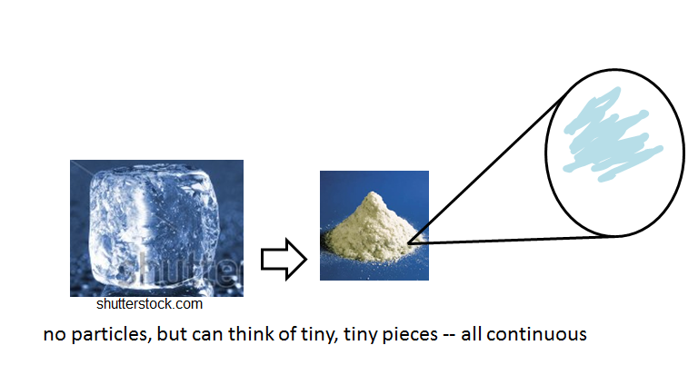
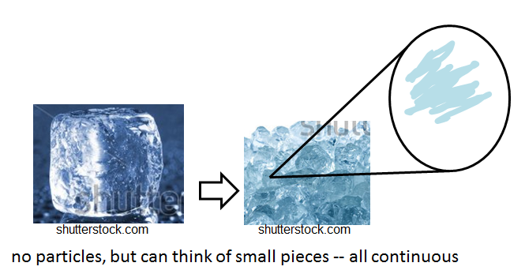
Matter Learning Progression: Structure and Properties
 | Level 1 Continuous Macroscopic model | Level 2 Microscopic Continuous model
Key words | observable macroscopic properties of liquids and solids; historical thinking; | material kinds of solids and liquids; mass and volume; historical thinking
Students’ mental model

Slide 30
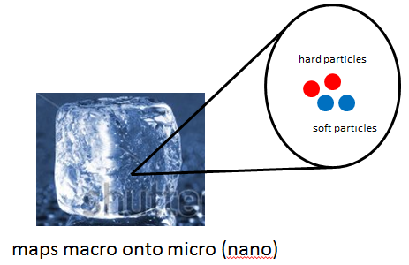
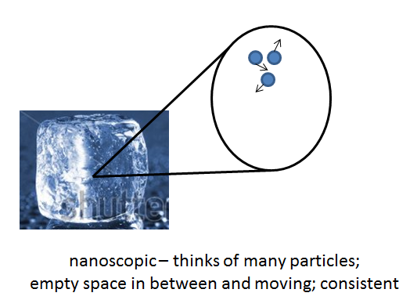
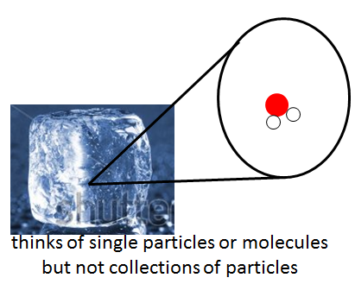
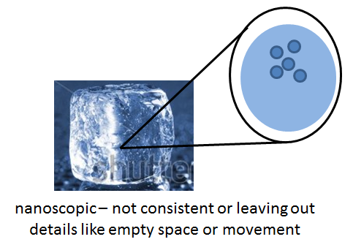
Matter Learning Progression: Structure and Properties
 | Level 3 Beginning Particle Model | Level 4 Particle Model
Key words | particles with macro properties mixing scales, matter in matter, Single particle | Particles with mass and volume; properties as a result of a collection of particles; interactions between particles; consistent application of nanoscopic level of material identity.
Students’ mental model

Slide 31
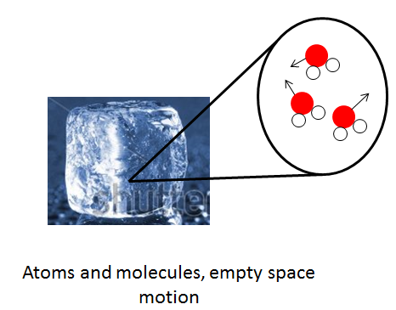
Matter Learning Progression: Structure and Properties
 | Level 5 Atomic Molecular model
Key words | Key words: Particles with mass and volume; properties as a result of a collection of particles; interactions between particles; consistent application of nanoscopic level of material identity
Students’ mental model

Slide 32
First Prototype Task: Features
Based on a competency model that integrates learning theory and standards
Contextualized by a scenario to promote motivation, engagement, and sense making through application of content and multiple practices
Provides scaffolds to promote productive engagement with content and practice and support learning
Uses simulations to support engagement, learning, and collect new evidence of proficiency
Will be part of a set of tasks to increase frequency of measurement and cover more content and practice
Will collect summarize and present student and class level data to teachers

Slide 33
First Prototype Task
Core idea and Grade Targets
One Core idea: Matter (Structure & Properties; Change)
Two-Three Grades: 5th-7th grade
Practice Targets
Modeling
Explanation
Argumentation
Engaging in Empirical Investigations
Planning and Carrying Out Investigations
Analyzing and Interpreting Data

Slide 34
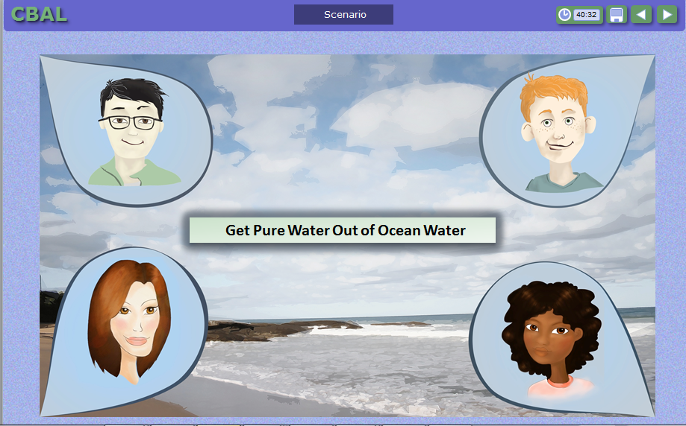
Selected Task Feature: Scenario-Based Context Engages students in solving world problem

Slide 35
Selected Task Feature: Simulations Allows students to demonstrate inquiry ability

Slide 36
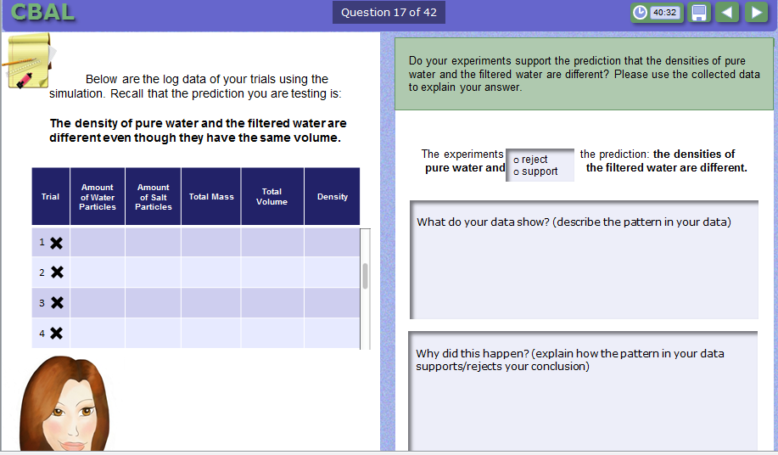
Selected Task Feature: Scaffolds
Remind and prompt students for knowledge needed
Provide a pathway for students and outlines the steps of the path

Slide 37
Summative Assessments
Also scenario-based
But provide less scaffolding
Aligned to same content and practice in the formative assessments
Provide end of unit diagnostic information

Slide 38
Future Directions
Immediate Future
Develop professional development materials to support use and implementation of assessments
Develop tasks to cover all middle school matter content
Piloting, validating, and revising LPs and tasks
Intermediate Long–term Future
Cover more content
Cover cross-cutting themes

Slide 39
Questions??

